Slide 1

Fundraising
Annual Plan
Presented by Kimberly Perron, MBA
Customer Success Instructor

Slide 2










Slide 3
POLL – Annual Fundraising Plans?
Has your organization created an annual fundraising plan in the past, and if so, how did that go?
No, this would be the first time we had a formal plan
Yes, we’ve had a plan, but didn’t really use it
Yes, we’ve had a plan, but we didn’t come close to any of our goals
Yes, we’ve had a plan, but we’d like to improve our process
Yes, we’ve had a plan and followed it with great success

Slide 4
Annual Plans – What went wrong?
Missing strategic plan and objectives
Lofty goals
Lack of action steps
No analysis of previous results
No schedule or accountability

Slide 5
Annual Plans – Benefit
Prioritize needs
Assigns resources
Team alignment
Focuses attention
Evaluate results for future improvement

Slide 6
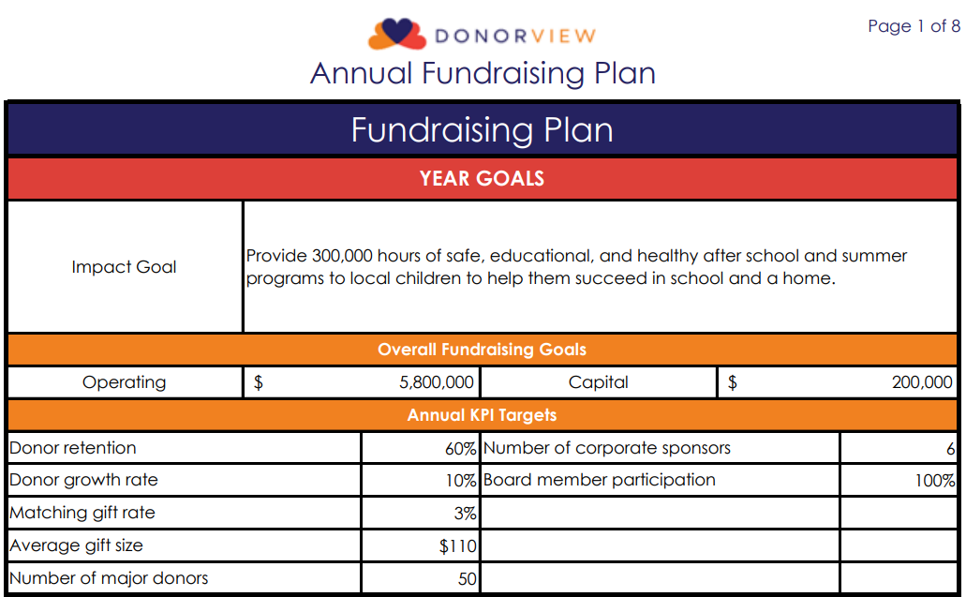
Annual Goals
Impact Goal
Fundraising Goals
Operating
Capital
KPI Targets

Slide 7
Impact Goal
Clear objective everyone can rally around
Easily demonstrates positive influence on community
Measurable, specific, simple
Stretch but achievable

Slide 8
Financial Goals
Operating and Capital
Based on objectives
Projections for demand/need
Fundraising usually focuses on revenue
Don’t lose sight of expenses

Slide 9
Key Performance Indicators
Chose a few related to objectives and revenue sources
Evaluate previous KPIs and direction
Identify the “whys”
Utilize your CRM to generate reports
Identify frequency of reports

Slide 10
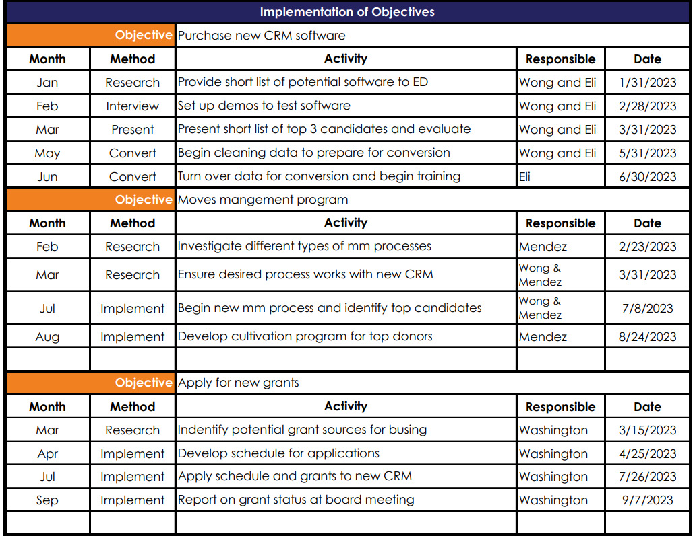
Implementation of Objectives
Target month
Method
Activities
Responsible
Target date

Slide 11
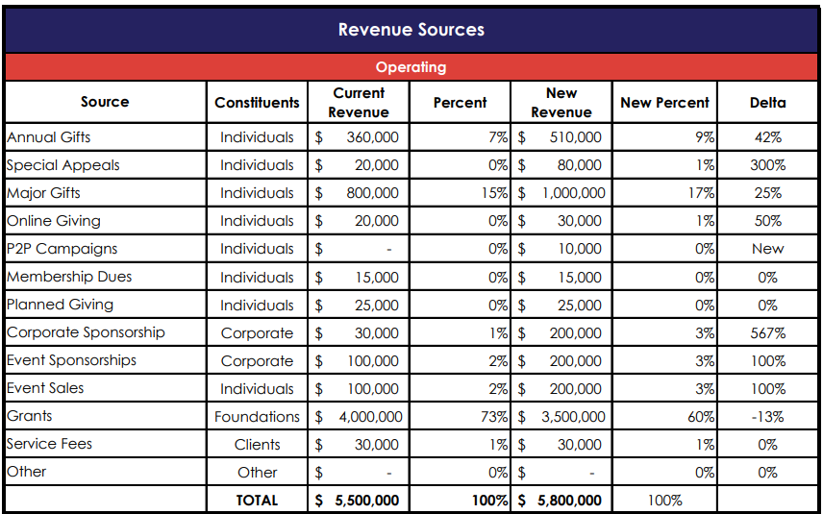
Sources of Revenue
Source
Constituent
Current vs. New
Delta

Slide 12
Sources of Revenue
Large deltas?
Is goal reasonable?

Slide 13
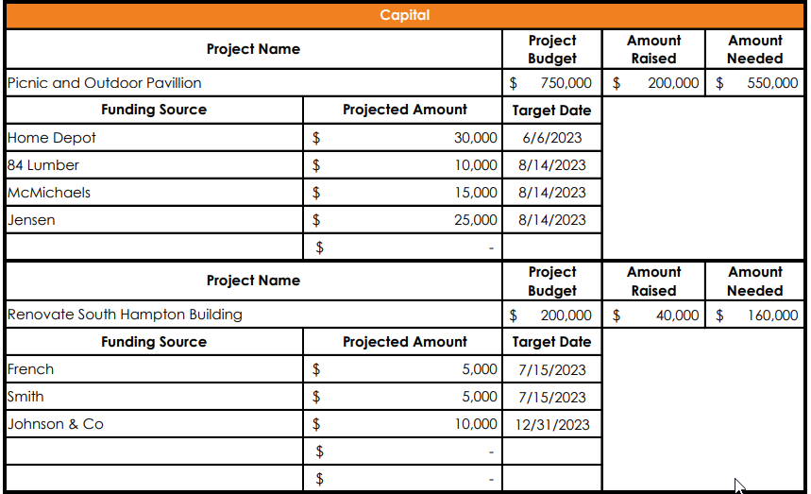
Capital Projects
Sources
Projected Amounts
Target Dates

Slide 14
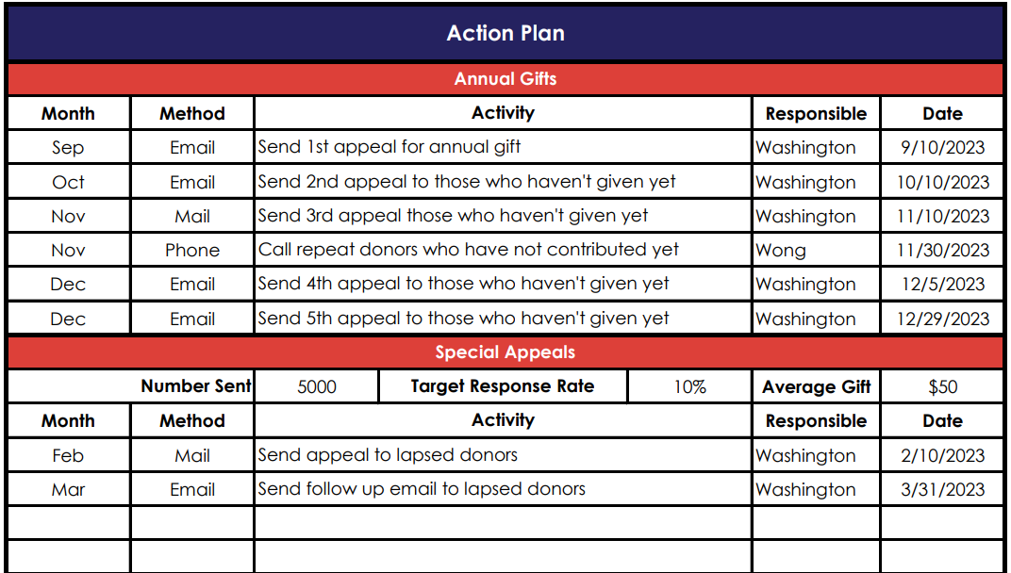
Action Plans
Month
Method
Activities
Responsible
Date
Can add analytics

Slide 15
POLL – Improving Response Rates?
What is your favorite “tip” for improving direct mail annual and special appeal response rates?
Making the donor the hero – using “you” instead of “we”
Adding a great P.S. to the signature block
Adding stories from clients
Using a live stamp
Including a reply envelope
Hand addressed envelope

Slide 16
Improving response rates – Make a plan
Making the donor the hero – using “you” instead of “we”
Adding a great P.S. to the signature block
Adding stories from clients
Using a live stamp
Including a reply envelope
Hand addressed envelope
Personalize your message
Update donors throughout the year
Try new channels
Add videos
Follow up with phone call

Slide 17
Improving Response Rates – Make a plan
Evaluate previous response rates
Review your list
Survey to identify their “why”
Include your impact goal
Focus on impact (more than outcomes)
Don’t forget the Call To Action (CTA)
Use multiple tactics – letters, emails, texts, social

Slide 18
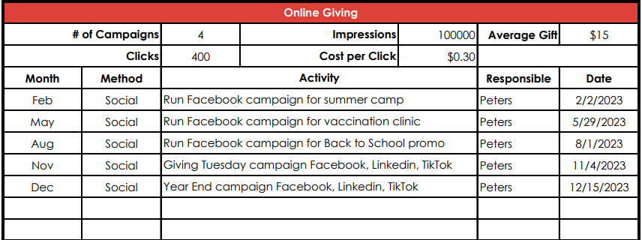
Online Giving
Choose your channel (surveys)
Use channel analytics
Identify your target

Slide 19
Online Giving – Improving Results
Know your audience
Establish purpose & goals (communications plan)
Mobile Optimized
Maintain branding – eye catching
Impact goal & CTA

Slide 20
POLL – Peer to Peer Campaigns?
Has your organization tried Peer to Peer Fundraising?
No, it’s not on our radar
No, but we are thinking about it
Yes, but it wasn’t as successful as we had hoped
Yes, it is one of our annual events

Slide 21
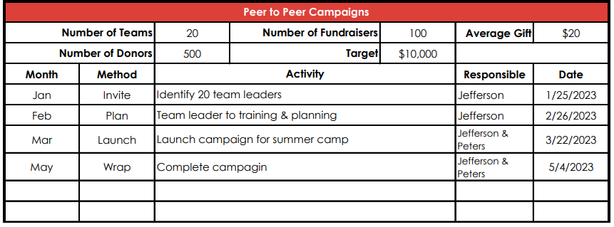
Peer to Peer Campaigns
Great for engagement
Needs a PM
Awards event

Slide 22
Peer to Peer Campaign Ideas
Color Run/Walk/Ride
Celebrity Chef
Dance Competitions
Christmas Tree Festivals
Bowling/Kickball/Volleyball
Park/Beach/Road Clean Up
Trivia Nights
Adopt-An-Animal/Classroom/Playground/Library

Slide 23
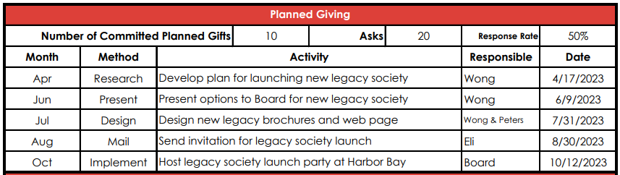
Planned Giving
Must have!
Part of donor engagement program
Can be simple or complex

Slide 24
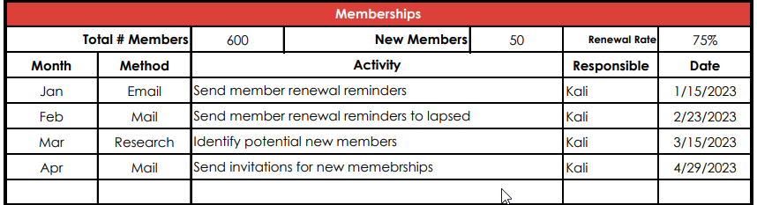
Memberships
Benefits
Visitors Members
Members Donors

Slide 25
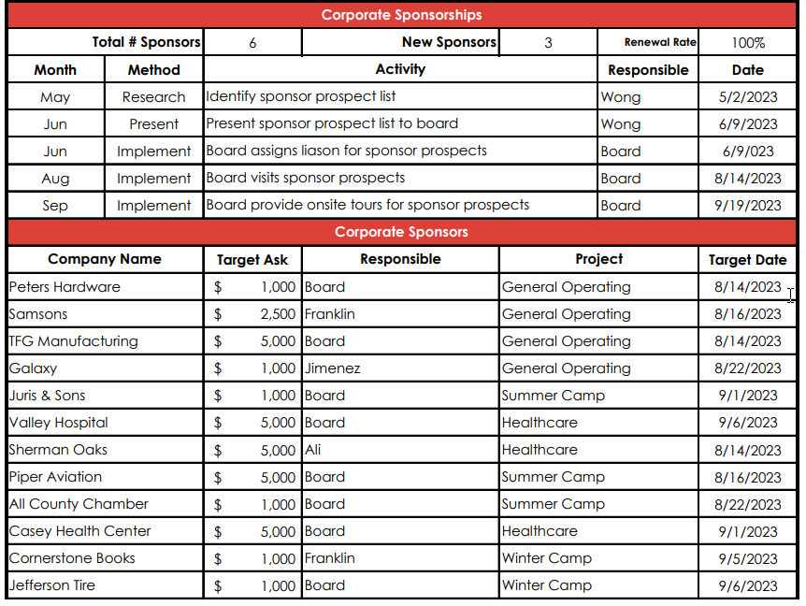
Corporate Sponsorships

Slide 26
Corporate Sponsorships
Separate from events
Identify organizations that have a natural connection
In-kind vs. Cash
Benefits –Deliverables
Access to your audience
Recognition and publicity

Slide 27
POLL – Grants?
What percentage of your annual revenue is from grants?
0% - we receive no grant funding
Less than 10%
11 – 30%
30 – 50%
Greater than 50%

Slide 28
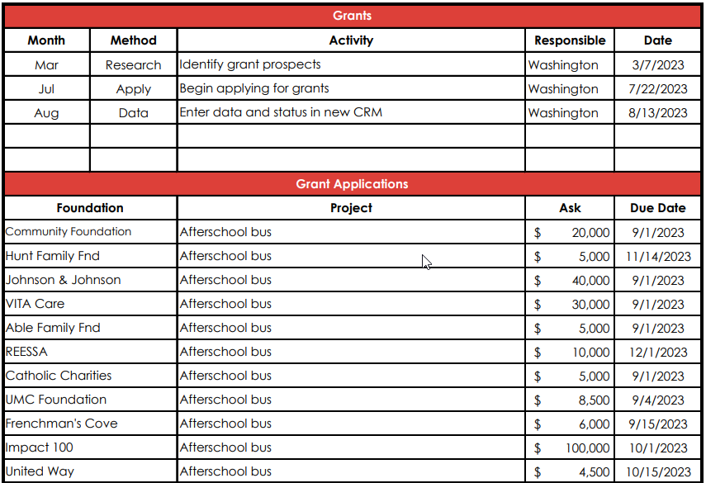
Grants

Slide 29
Grants – improving results
Identify the right funders
Ensure you are ready for funding
Put the time in to prepare
Make it specific not generic
Tell a story
Demonstrate impact (no headcounts!)
Realistic budgeting and timelines
Don’t give up after 1st rejection

Slide 30
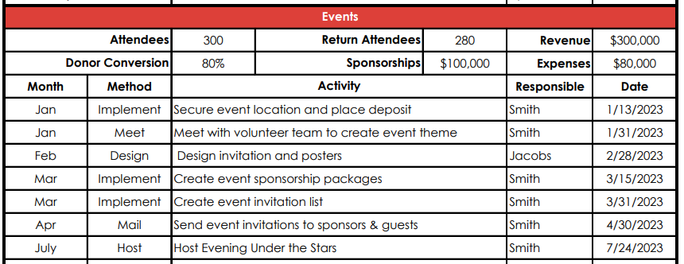
Events

Slide 31
Events – evaluating past results
Invite response rates
Repeat sponsors
Event attendee feedback
Auctions/Paddle Raise/Raffles/Pulls results
Expenses

Slide 32
Events – improving results
Sponsorships
Ticket sales
Bundle tickets
Early bird pricing
Table captains
New sources of revenue
Enticing entertainment
Raffles
Auctions

Slide 33
POLL – Moves Management?
Does your organization have a formal donor engagement or moves management process?
No, we don’t solicit major gifts
Not yet, but we would like to
Yes, but it isn’t producing the results we want
Yes, we have a formal process to cultivate donors for major gift fundraising

Slide 34
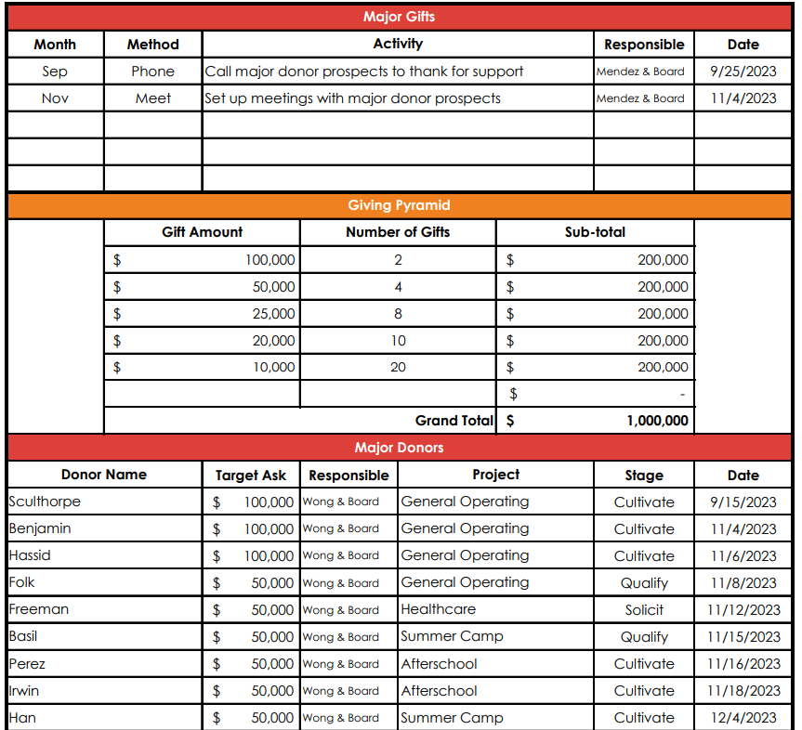
Major Donors

Slide 35
Major Donors – improving results
Implement a donor engagement or moves management process
Engage the board
Evaluate previous responses to proposals
Establish goals – giving pyramid
Use CRM to track stage
Schedule interactions
Connect to donor’s personal mission to customize proposals

Slide 36
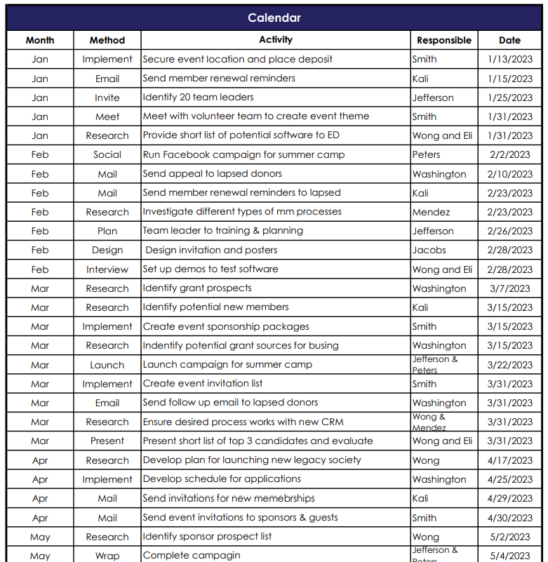
Calendar
Add all milestones & key activities
Can sort by date or responsibility
Identify potential issues

Slide 37
Download the free Fundraising Plan Excel worksheets Donorview.com/AFPwebinar
Next Steps
Register at AFP Global for next webinars
September 7^{th -} “Improving Your Annual Fundraising Plan with Donor Engagement”
December 6th - “Measuring and Evaluating the Results of your Fundraising Strategy and Plan with KPIs”

Slide 38
Questions?

Slide 39
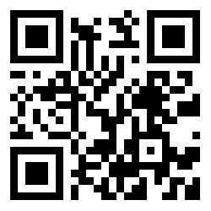
THANK YOU!
Request a Demo
Scan to visit our website and set up a free demo!
DonorView.com/Demo
Contact Us:
508-205-0243
sales@donorview.com
donorview.com

